Slide 1

Welcome to Sabbath School
Illustration by Jo Card. Copyright © 2024 General Conference Corporation® of Seventh-day Adventists.

Slide 2

EARLY ARRIVALS
EARLY
ARRIVALS

Slide 3
Welcome to Sabbath School
Illustration by Jo Card. Copyright © 2024 General Conference Corporation® of Seventh-day Adventists.

Slide 4

God Is So Wonderful
OPENING ACTIVITIES
Our God is so wonderful,
Our God is so great.
We want to worship You,
And praise Your mighty name.
Our God is so powerful,
We lift Your name on high.
We worship You,
And love to give You praise.
(Repeat above)
"God Is So Wonderful" by Kimberly Houliston, copyright © 2011 Abide Family Ministries. Used by permission.

Slide 5

God Is My Faithful Friend
OPENING ACTIVITIES
God’s promises are always true.
What God has promised, He will do.
God’s promises are always true.
What God has promised, He will do.
God is my faithful Friend.
I can always trust in Him.
All the promises of God in Christ
Are “yes” and “amen.”
God is my faithful Friend.
(Repeat above)
"God Is My Faithful Friend" by Rosie Smith, copyright © 2024 General Conference Corporation® of Seventh-day Adventists.

Slide 6
Be Still, Be Silent
OPENING ACTIVITIES
Be still, be silent
As we talk to the King of kings.
He knows and hears you.
You can tell Jesus anything.
(Repeat above)
Let’s close our eyes,
And kneel before our King.
Amen.
“Be Still, Be Silent” by Rosie Smith, copyright © 2024 General Conference Corporation® of Seventh-day Adventists.

Slide 7

PRAYER
PRAYER

Slide 8
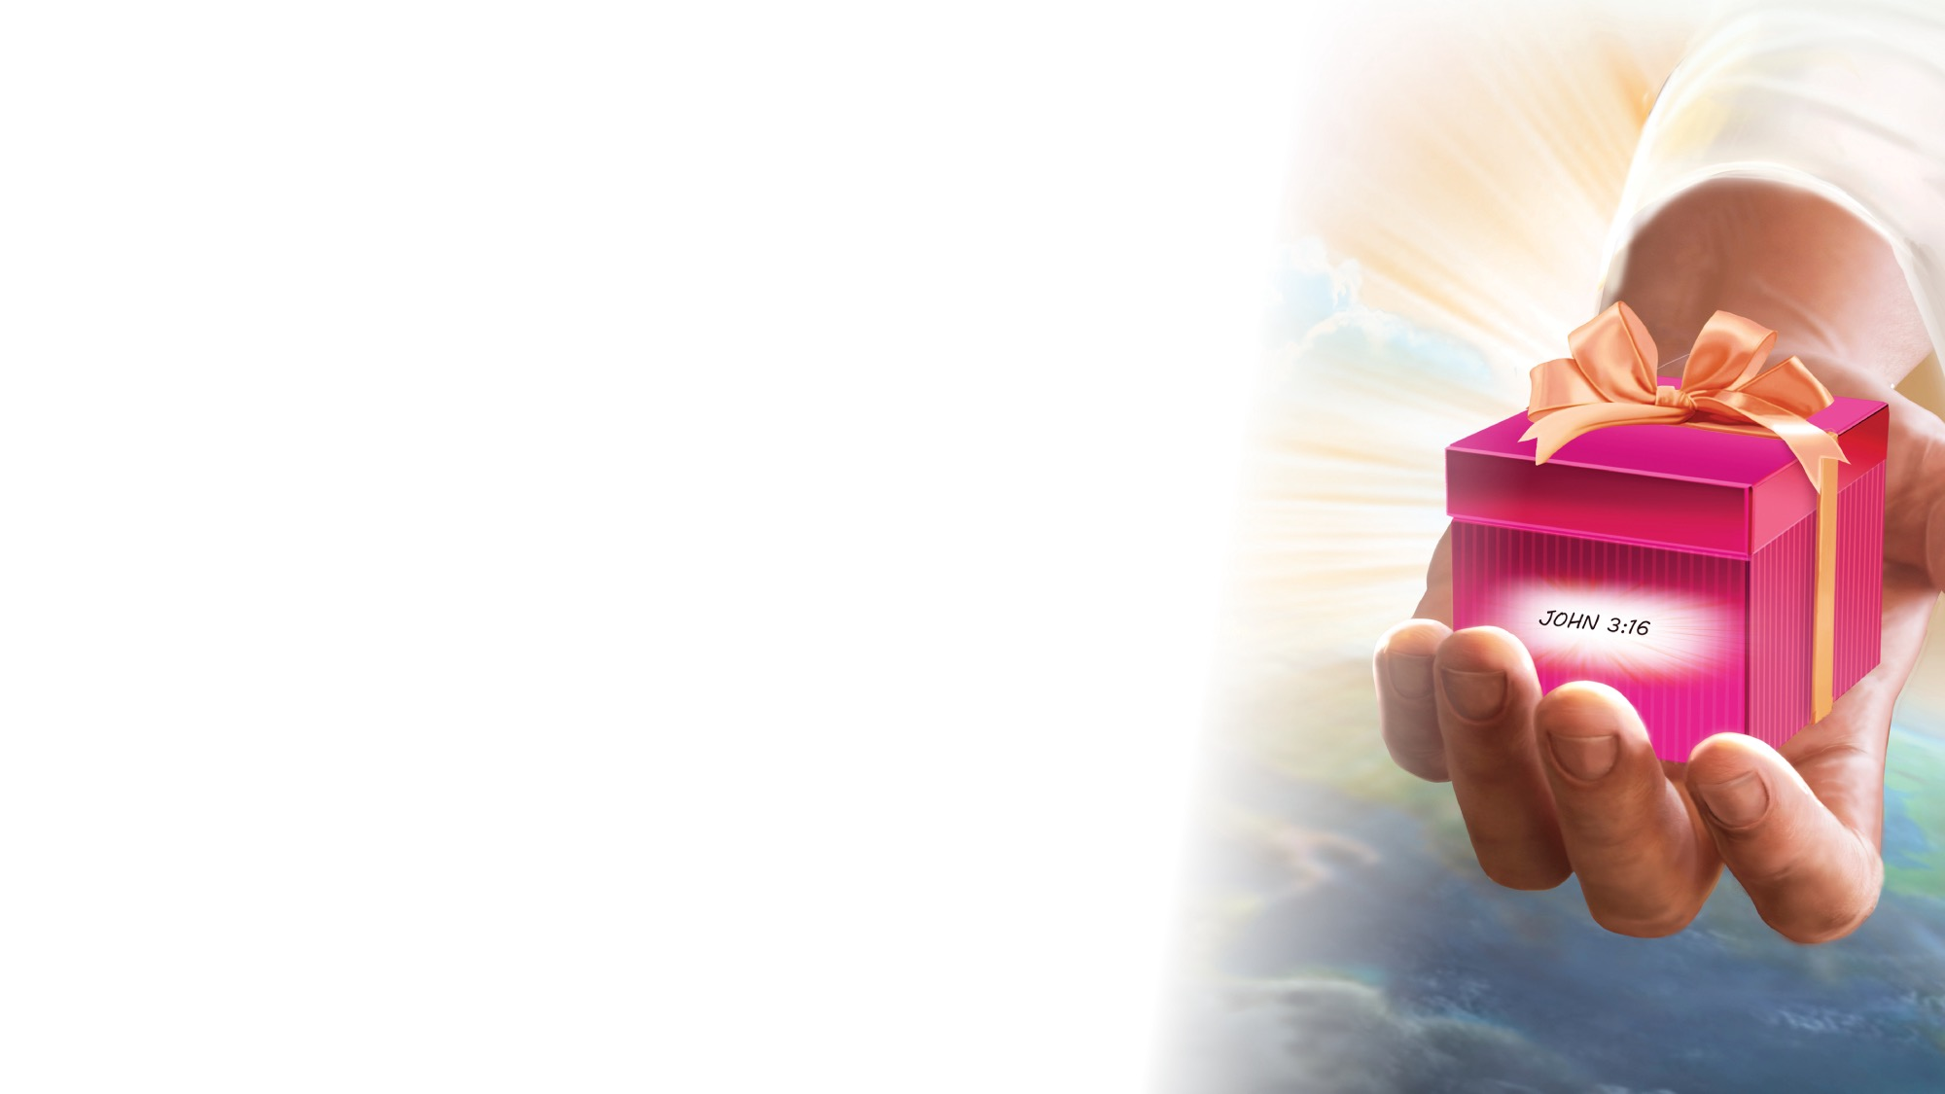
OFFERING

Slide 9

Thank You, Jesus
OPENING ACTIVITIES
Thank you, Jesus
For providing all my needs.
I want to give a little back
Of what you’ve given me.
Please bless our
Sabbath School offering.
May it bring You glory
And help others in need.
(Repeat above)
May it bring You glory
And help others in need.
"Thank You, Jesus" by Rosie Smith, copyright © 2024 General Conference Corporation® of Seventh-day Adventists.

Slide 10
MISSION
FAST FACT &
OFFERING
CHART

Slide 11
Visitor Song
OPENING ACTIVITIES
We have a new friend
With us today.
We have a new friend.
Let’s smile and wave.
We welcome you to Sabbath School.
We’re glad you came.
We welcome you,
And hope to see you again. (x2)
“Visitor Song” by Rosie Smith. Copyright © 2025 General Conference Corporation® of Seventh-day Adventists.

Slide 12
Happy Birthday
OPENING ACTIVITIES
Happy birthday, happy birthday,
Happy birthday to you.
Jesus loves you dear ___________.
Happy birthday to you.
(Repeat above)
“Happy Birthday” by Janet Sage, copyright © 2001 North American Division Corporation of Seventh-day Adventists. From Little Voices Praise Him, #39. Used by permission.

Slide 13

FOCUS
ACTIVITIES

Slide 14
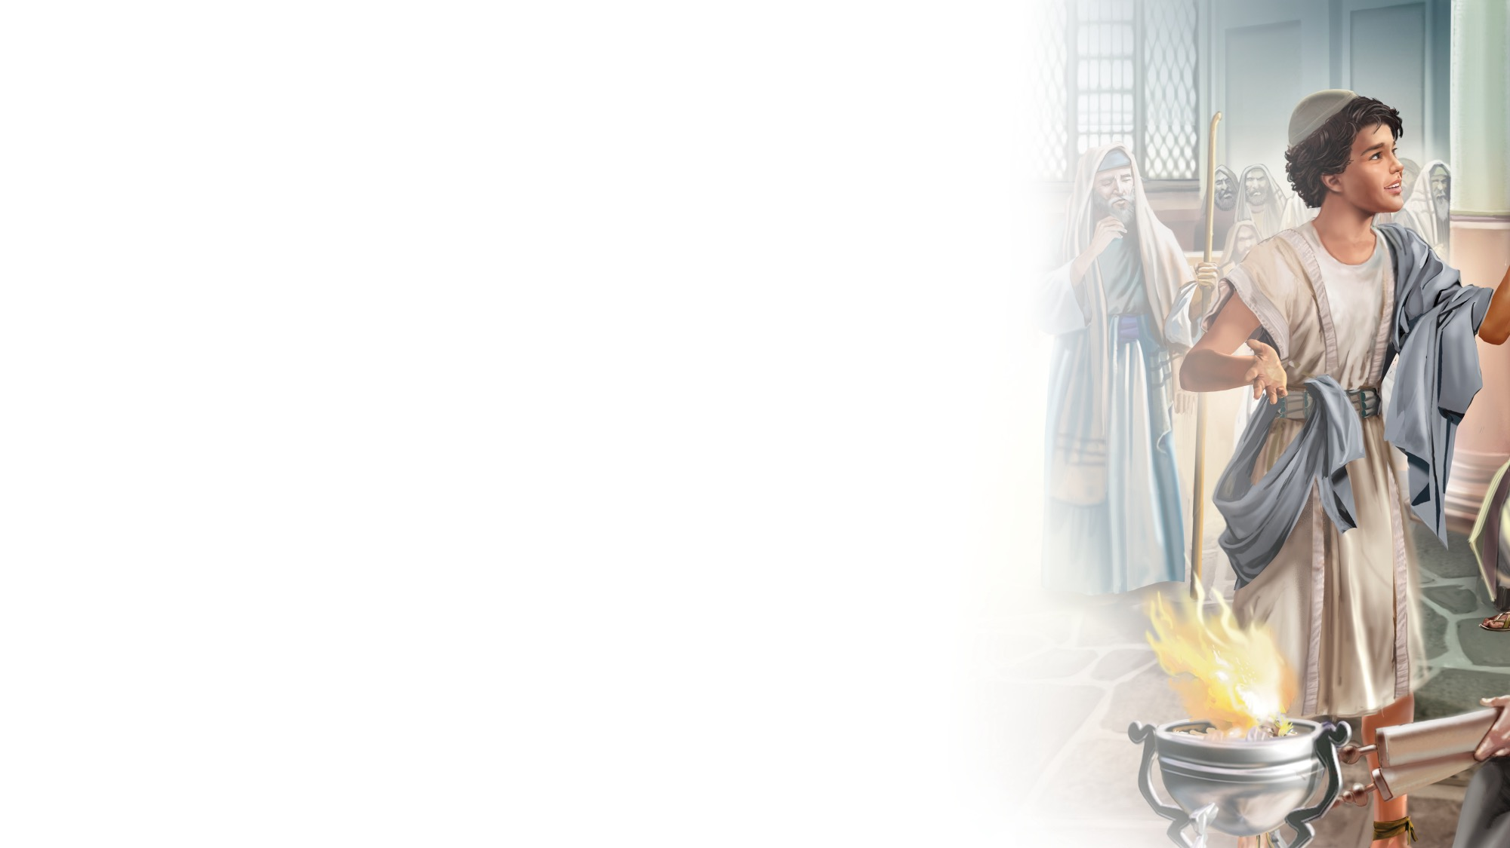
BIG IDEA
Jesus is my example as
I grow up.

Slide 15

BIBLE
STORY

Slide 16


Slide 17
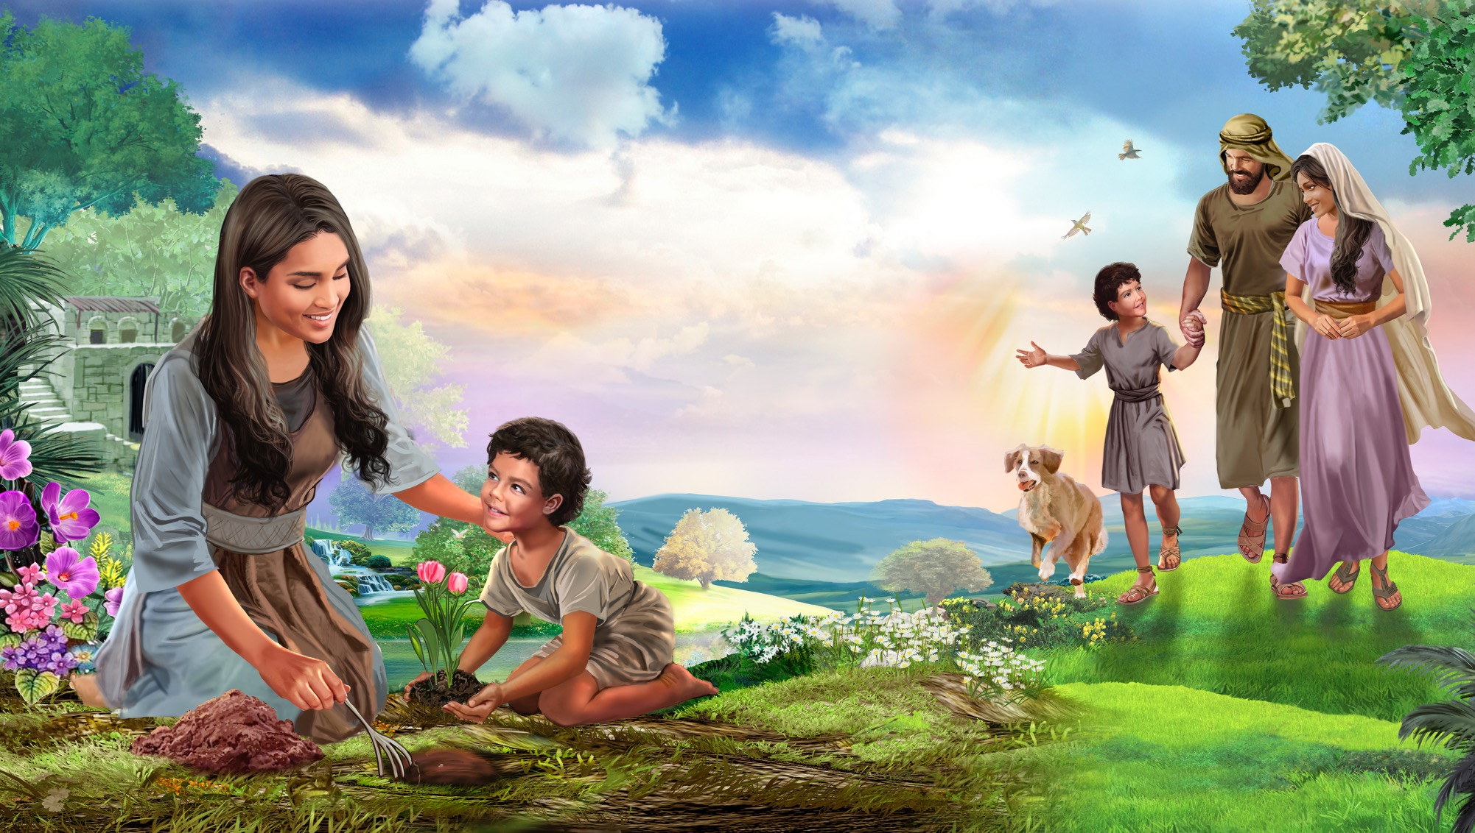
Illustration by Jo Card. Copyright © 2024 General Conference Corporation® of Seventh-day Adventists.

Slide 18
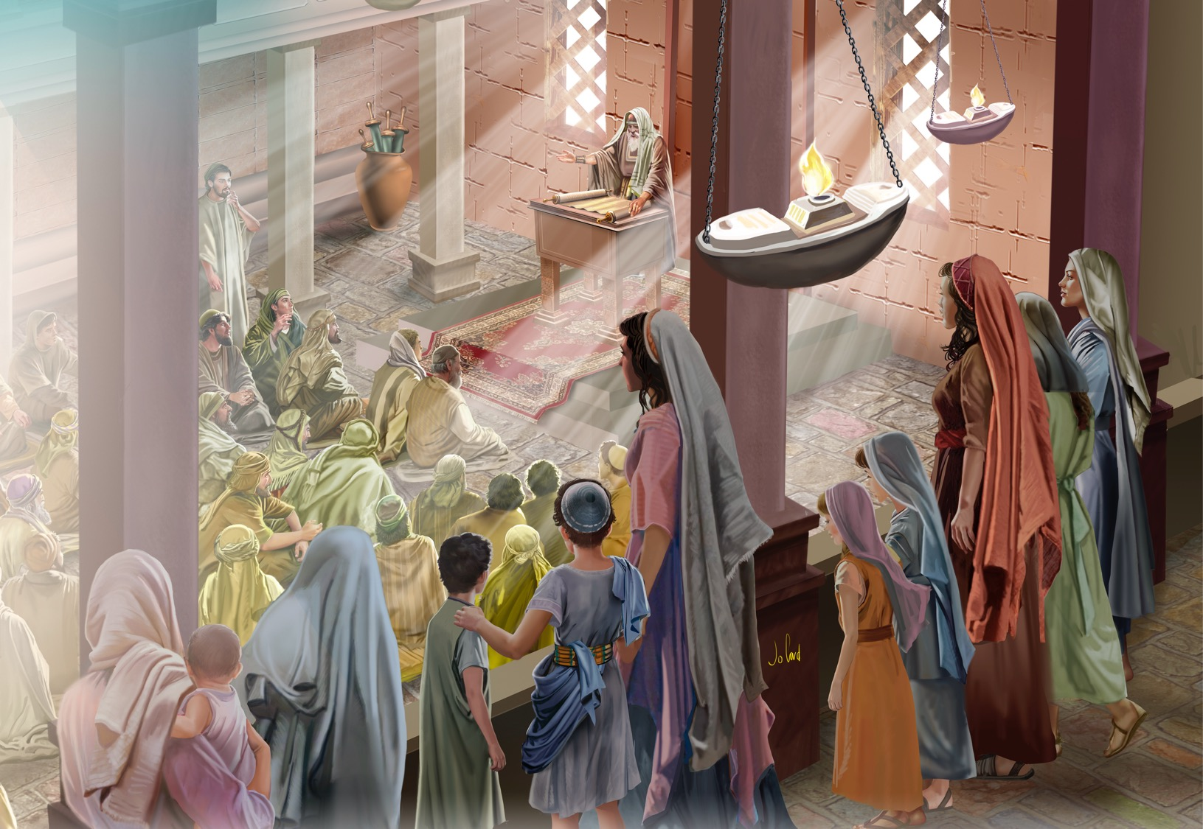
Illustration by Jo Card. Copyright © 2024 General Conference Corporation® of Seventh-day Adventists.

Slide 19
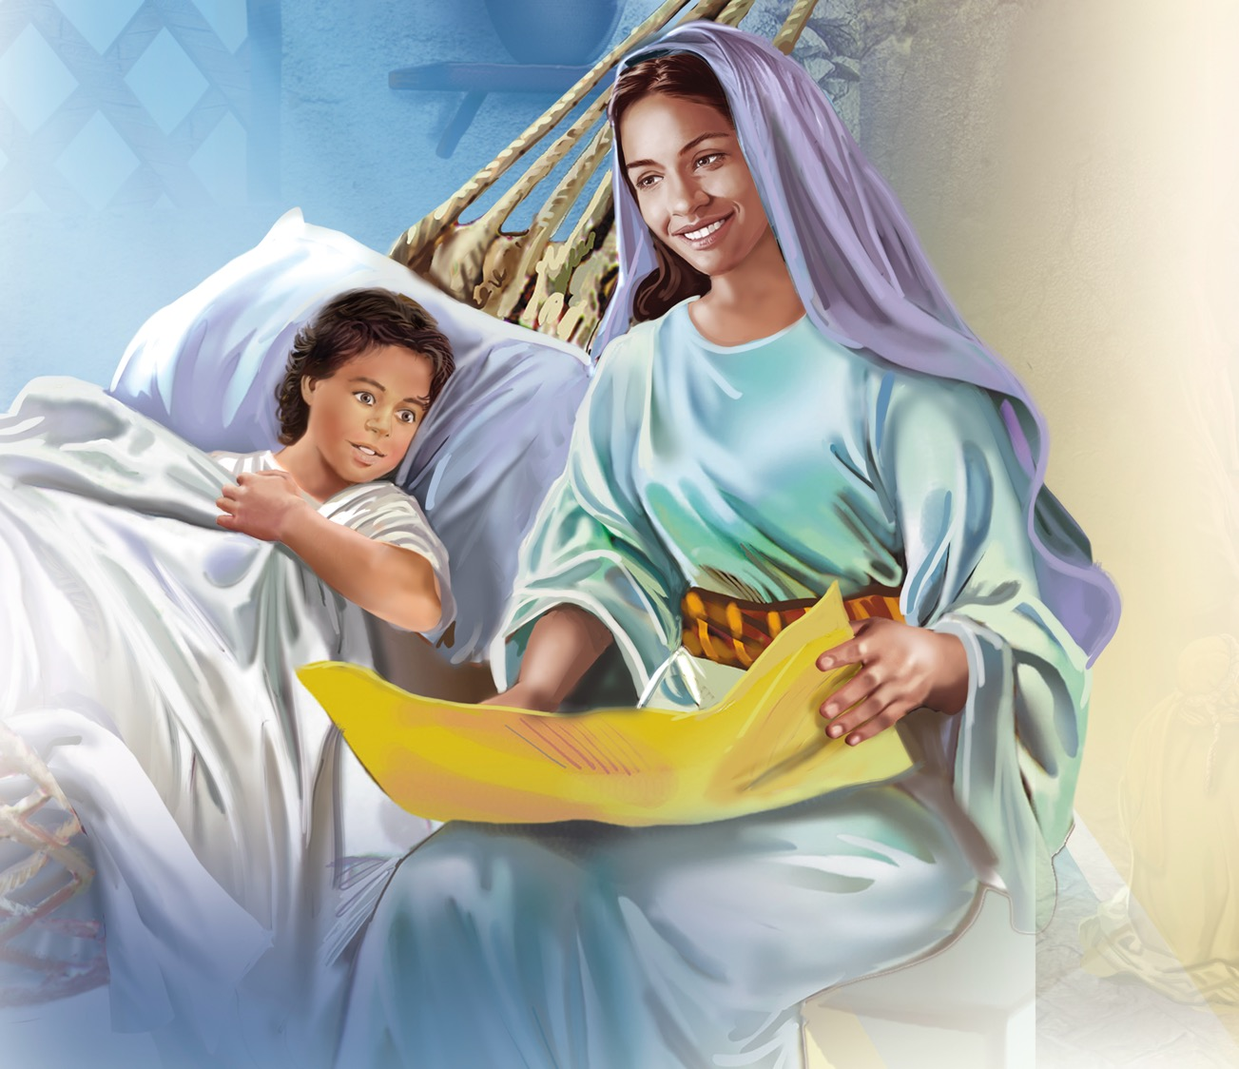
Illustration by Jo Card. Copyright © 2024 General Conference Corporation® of Seventh-day Adventists.

Slide 20
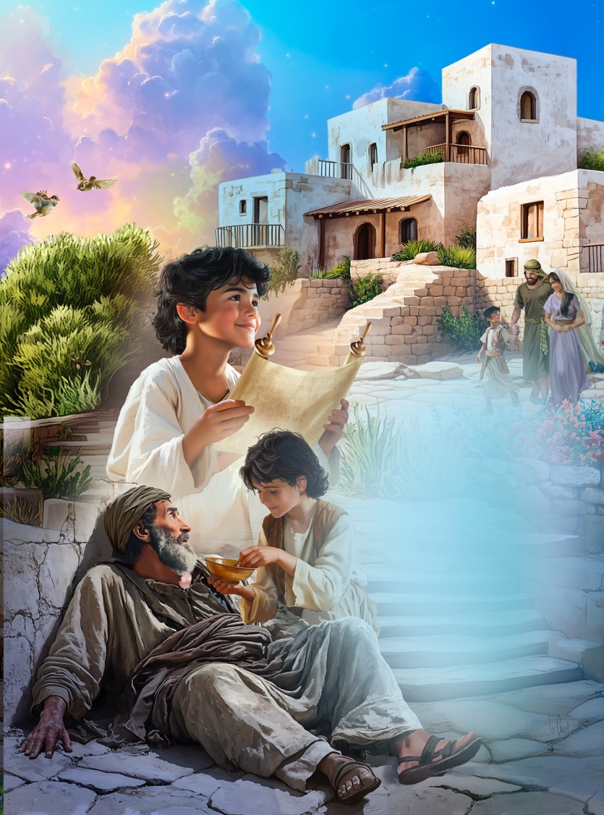
Illustration by Jo Card. Copyright © 2024 General Conference Corporation® of Seventh-day Adventists.

Slide 21
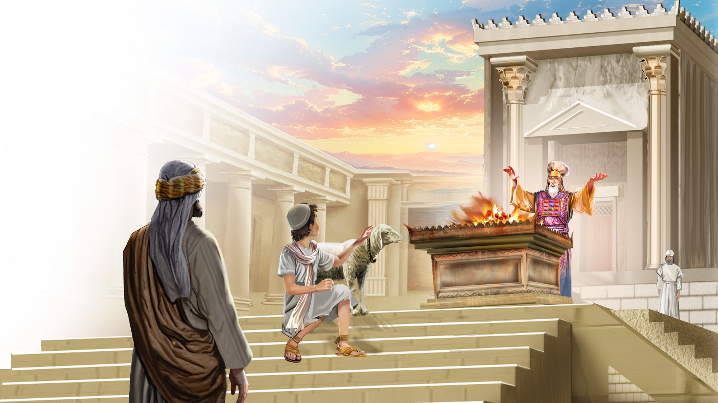
Illustration by Jo Card. Copyright © 2024 General Conference Corporation® of Seventh-day Adventists.

Slide 22
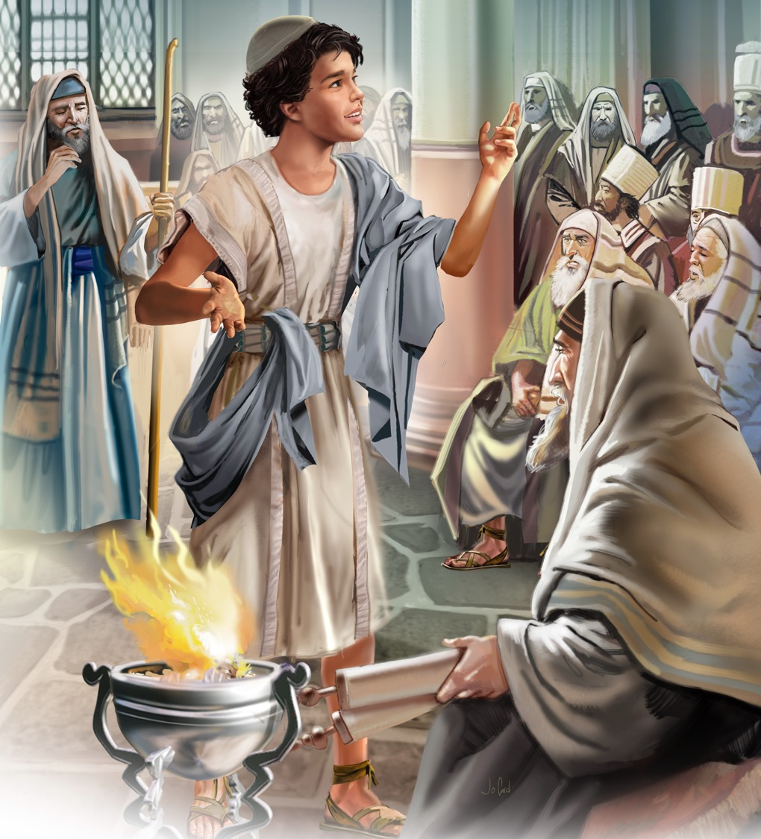
Illustration by Jo Card. Copyright © 2024 General Conference Corporation® of Seventh-day Adventists.

Slide 23
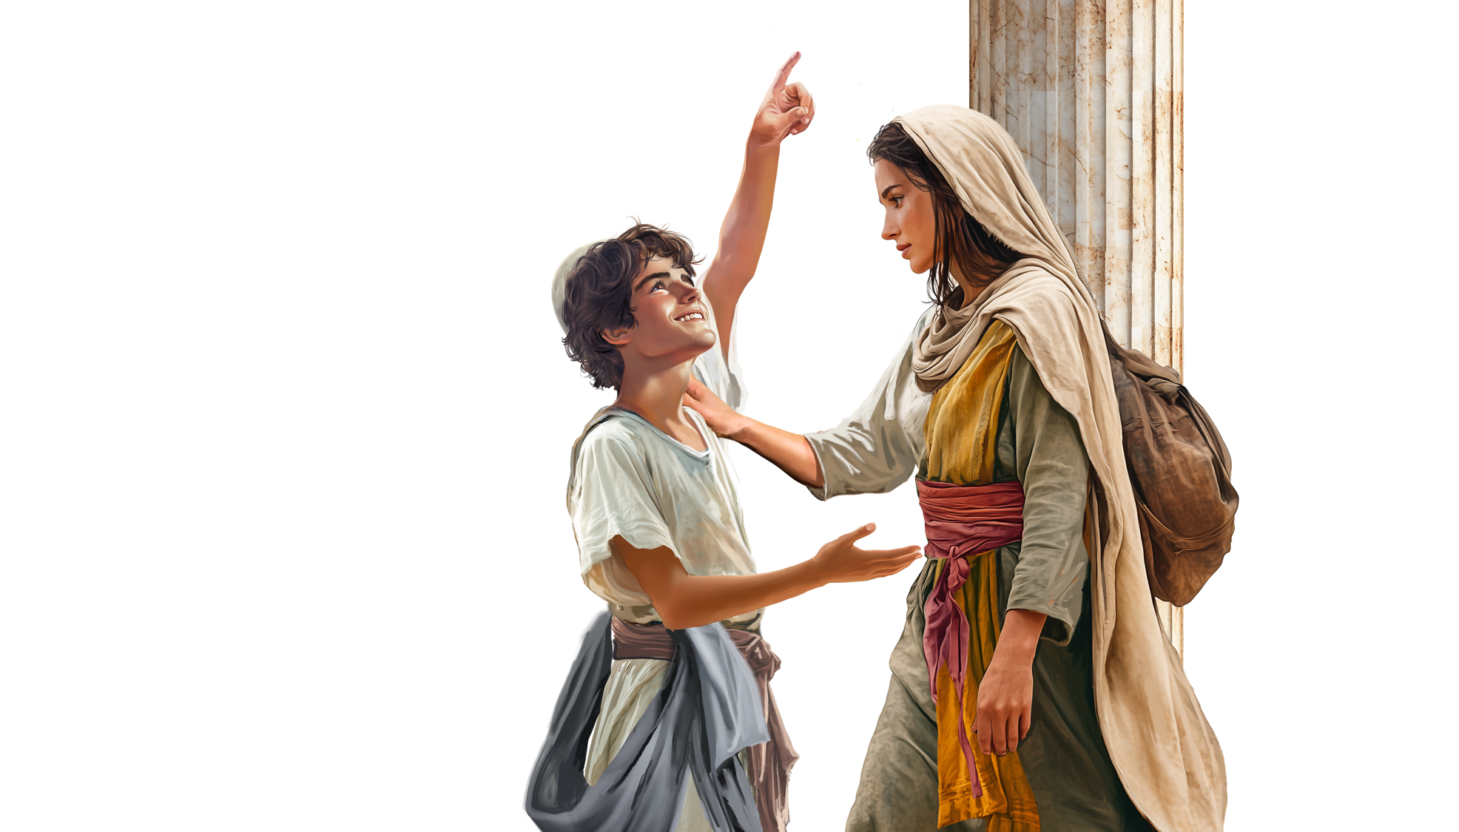
Illustration by Jo Card. Copyright © 2024 General Conference Corporation® of Seventh-day Adventists.

Slide 24
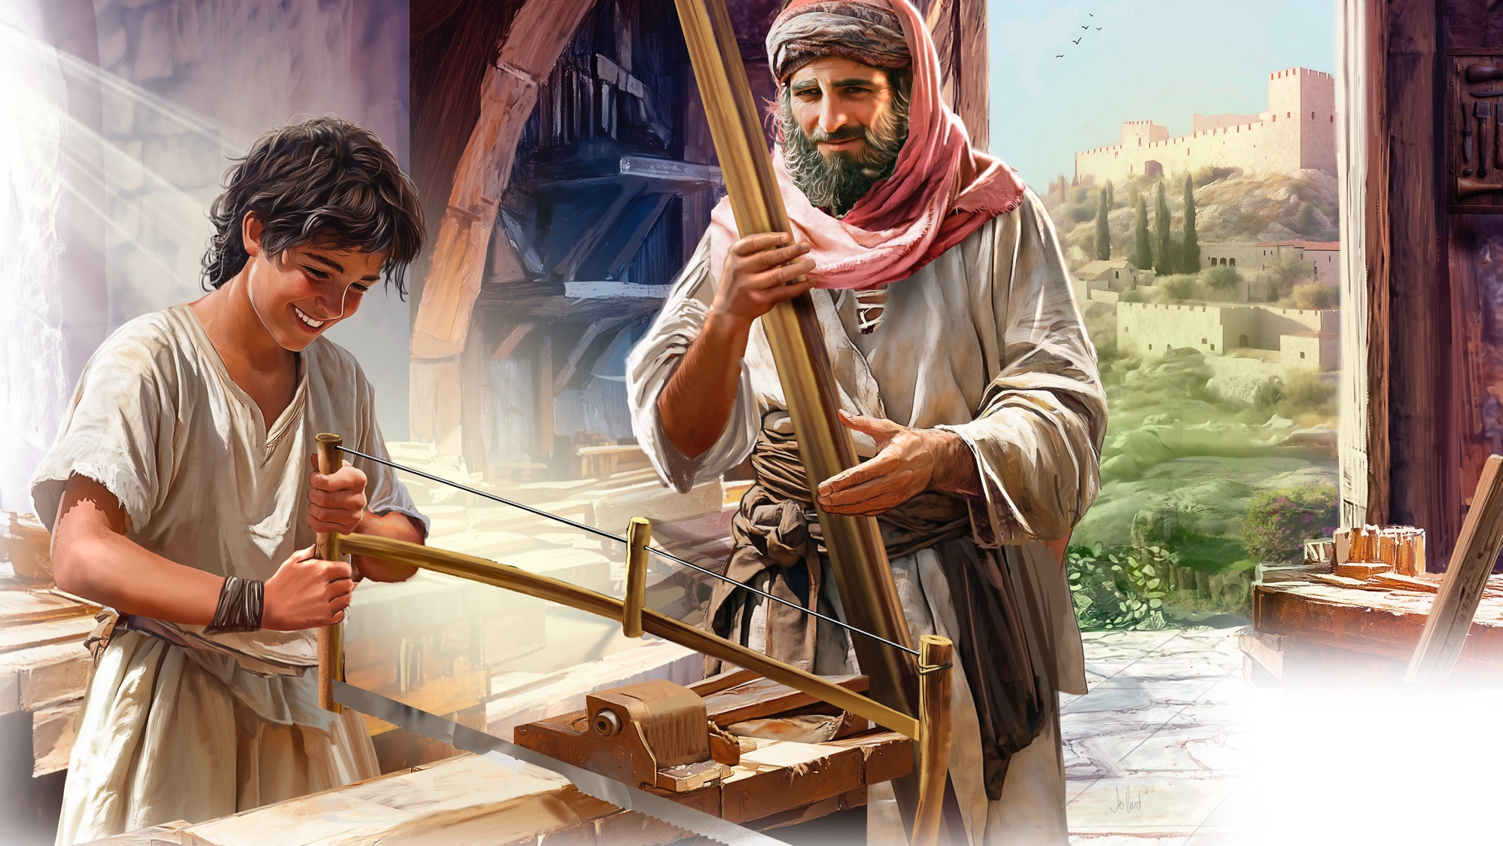
Illustration by Jo Card. Copyright © 2024 General Conference Corporation® of Seventh-day Adventists.

Slide 25
UNPACK
THE STORY

Slide 26
BIG IDEA
Jesus is my example as
I grow up.

Slide 27

CHARACTER CARDS

Slide 28
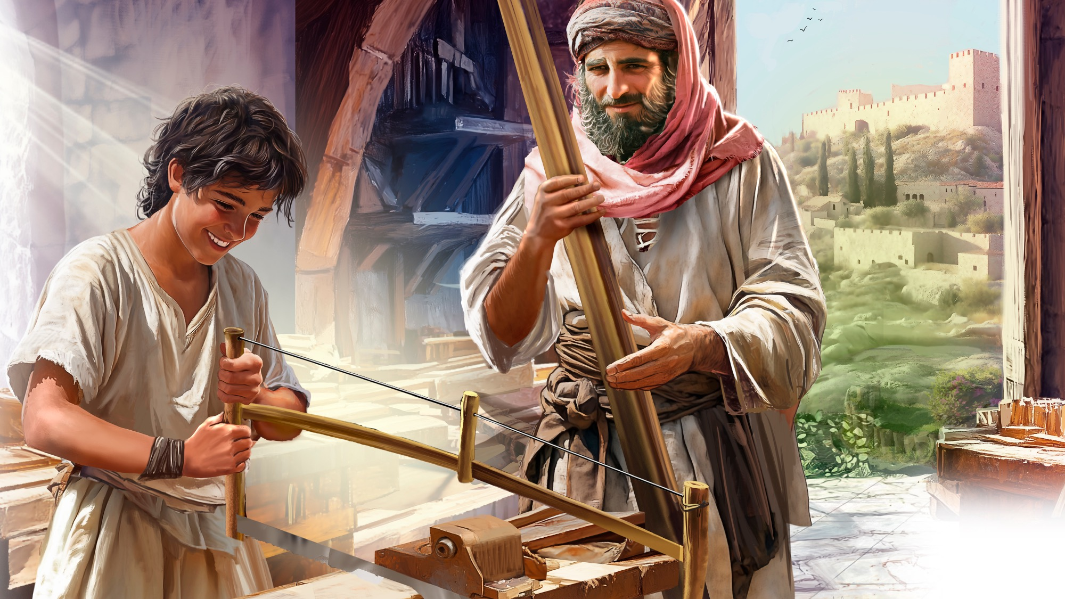
MEMORY VERSE
“. . . but grow in the grace and knowledge of our Lord and Savior Jesus Christ. To Him be the glory both now and forever. Amen.”
2 Peter 3:18

Slide 29
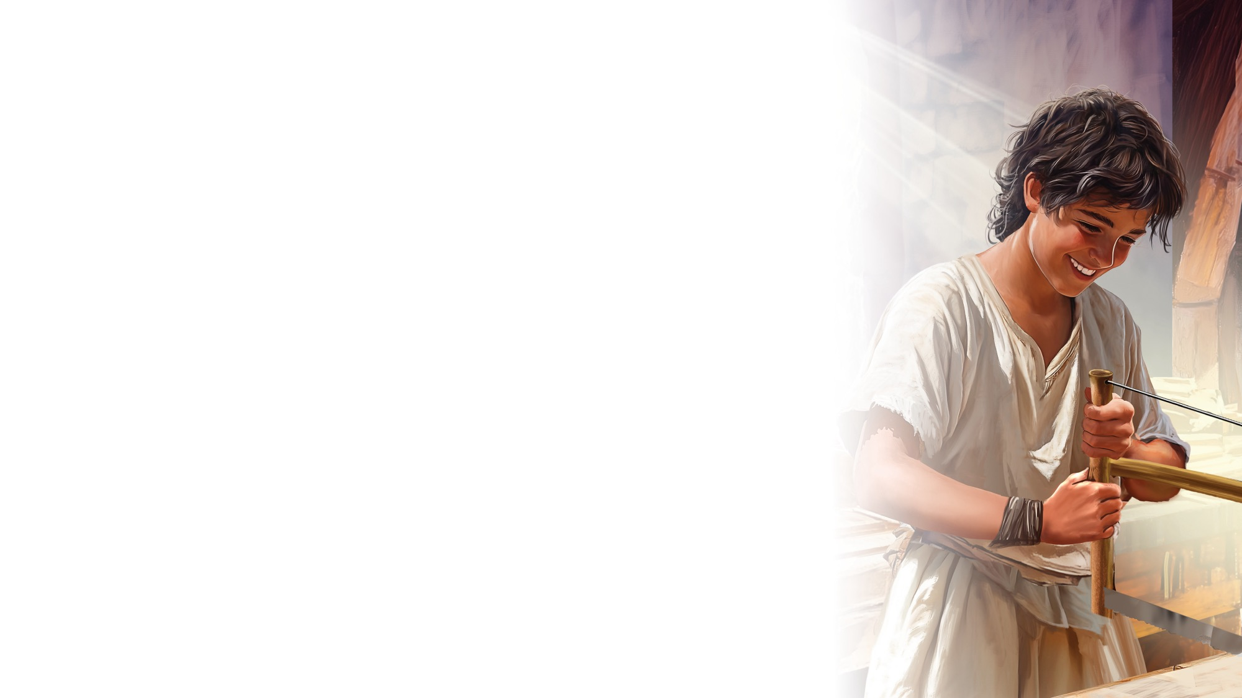
2 Peter 3:18
SCRIPTURE SONG
But grow in the grace
And knowledge of our
Lord and Savior Jesus Christ.
To Him be the glory
Both now and forever.
Ooooo, Amen.
Second Peter 3 verse 18.
(Continued on next slide)

Slide 30
2 Peter 3:18
SCRIPTURE SONG
But grow in the grace
And knowledge of our
Lord and Savior Jesus Christ.
To Him be the glory
Both now and forever,
Now and forever. Amen.
Second Peter 3 verse 18.
"2 Peter 3:18" music by Rosie Smith, copyright © 2026 General Conference Corporation® of Seventh-day Adventists.

Slide 31

MISSION
STORY

Slide 32

CRAFT

Slide 33
Books of the Bible
CRAFT

Slide 34
MISSION
CHALLENGE

Slide 35
BIG IDEA
Jesus is my example as
I grow up.

Slide 36

God Bless You
CLOSING SONG
What did you enjoy today?
What did you learn that’s new?
It’s time for us to say,
“Goodbye, and see you soon.”
(Repeat above)
We’ll see you again,
So until then, God bless you.
We’ll see you again,
So until then, God bless you.
God bless you!
"God Bless You" by Rosie Smith, copyright © 2025 General Conference Corporation® of Seventh-day Adventists.

Slide 37

PRAYER
PRAYER

